Slide 1
MOBILE APPLICATION SYSTEM DESIGN
(Week 1)
Nurul Amera Muhamad Nazmi

Slide 2
CONTENT
Course introduction
Introduction to Mobile Application
Operating system for Android and iOS
Mobile application market trends and statistic
Mobile application research and design
Class Discussion : What is your dream app?
Project Management and Tools

Slide 3
COURSE INTRODUCTION – LEARNING OUTCOMES
Demonstrate ability to apply the mobile application architecture.
Evaluate navigation schemes in mobile application.
Analyze related programming languages to develop basic features in mobile application.
Display an awareness for continuous learning and analysis of mobile application
technology.

Slide 4
CONTINUOUS ASSESSMENT
Course Introduction – Assessment Structure
Assignment 1 (40%)
Assignment 2 (30%)
Final Assessment
Final project (30%)

Slide 5
Course Introduction – Expectation
Punctual
Alert to course announcements and assessment instructions
No late submission of assessment tasks without a valid reason

Slide 6
Course Introduction – Lecturer Contact Information
Lecturer: Nurul Amera
Email: nurulamera.nazmi@xmu.edu.my
Consultation Hours (Appointment basis)
Friday: 12 pm – 3 pm
Thursday: 10am – 11am
(Please email or Team Chat me before coming for consultation)

Slide 7

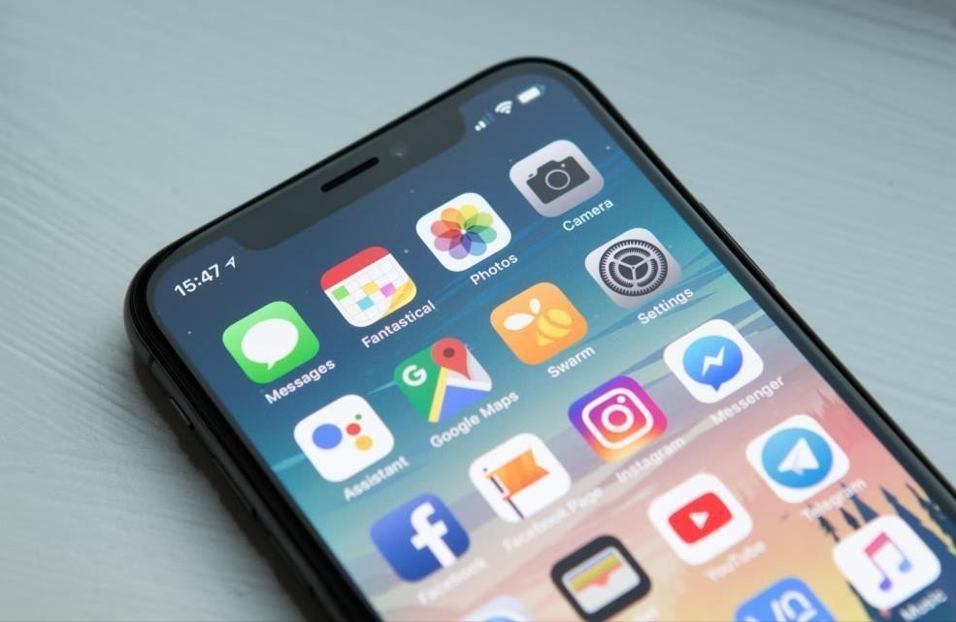
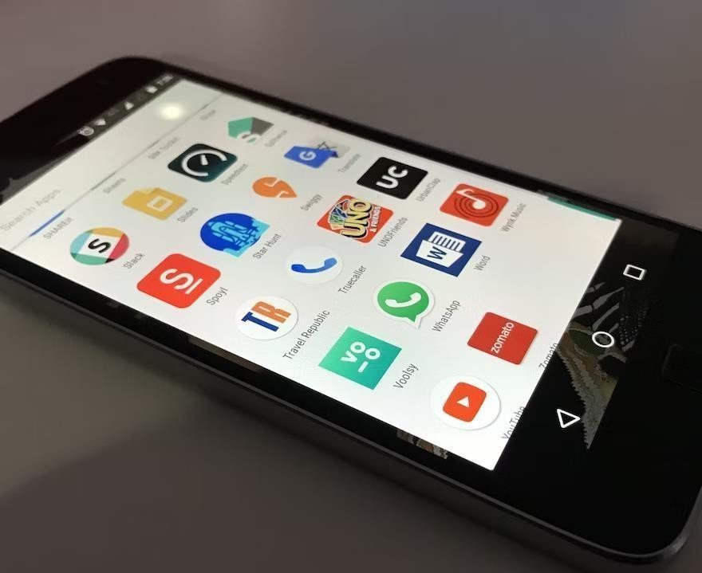
INTRODUCTION TO MOBILE APPLICATION
SYSTEM DESIGN
What is a mobile application?
A mobile application, most commonly called an app, is software designed to run on a mobile device, such as a smartphone or tablet computer.
Mobile applications frequently provide users similar services to those accessed on PCs. Apps are generally small, individual software units with limited functions.

Slide 8
Introduction to Mobile Application
Three main types of mobile apps:
Native
Web
Hybrid

Slide 9
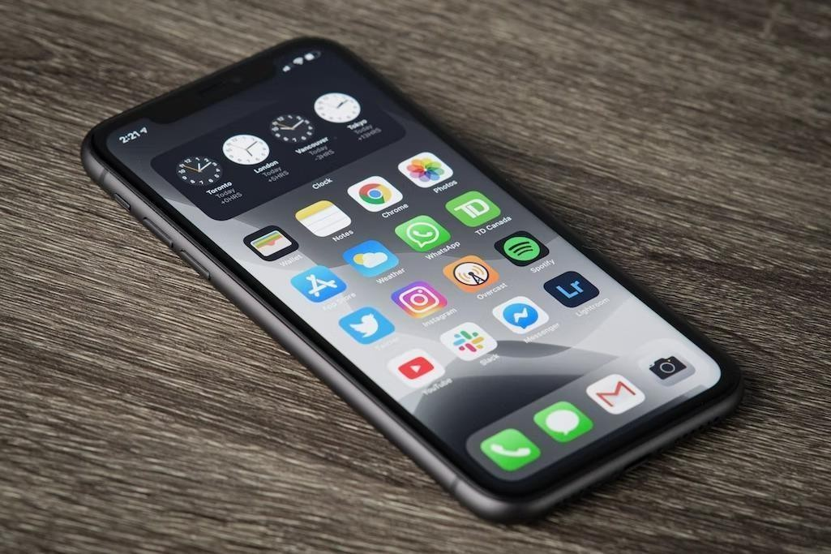
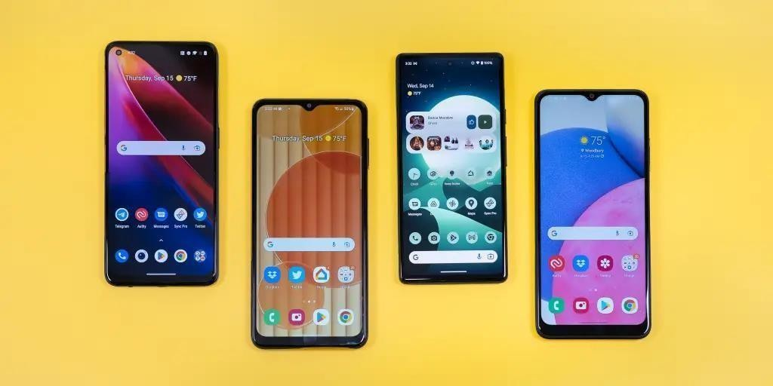
Introduction to mobile application
Native Mobile App
App that is developed for one particular operating system
Native mobile apps are designed to be “native” to one platform, whether it’s Apple’s iOS, Google’s Android, or others.
The native platform can be advantageous because it optimizes the user experience.
Because it was developed specifically for the
platform, it can operate more quickly and intuitively.

Slide 10
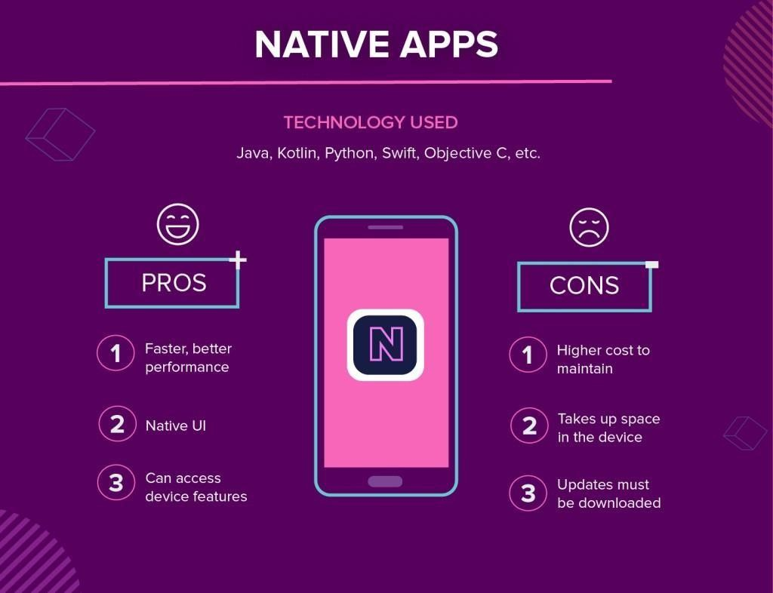
Introduction to mobile application

Slide 11
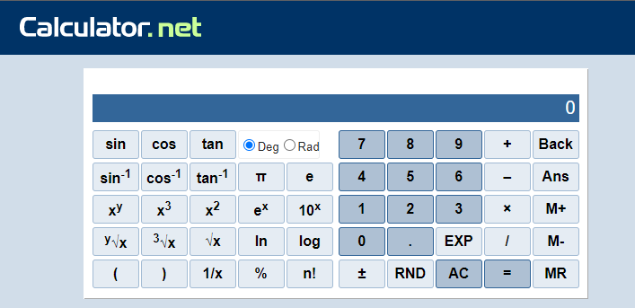
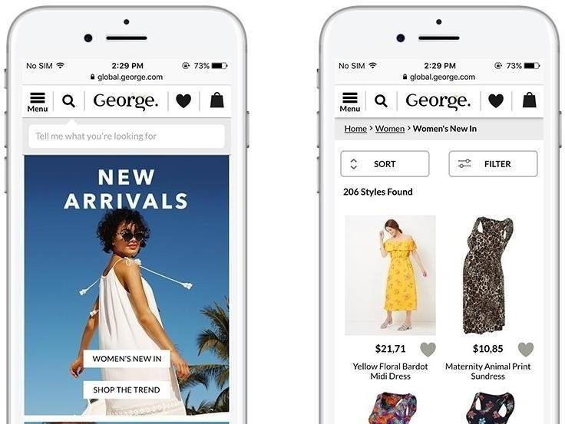
INTRODUCTION TO MOBILE APPLICATION
Web Apps
An application program that is stored on a remote server and delivered over the internet through a browser interface.
Commonly used web applications can include webmail,
online calculators or e-commerce shops.
Users don't need to install the app and can access the app through various platforms such as a desktop, laptop or mobile via browser.
However, a web app operates relatively at a slower
speed than the application hosted on a local server
As web applications are not native, they cannot sometimes effectively collaborate with all the hardware and operating systems of the specific devices you use.

Slide 12
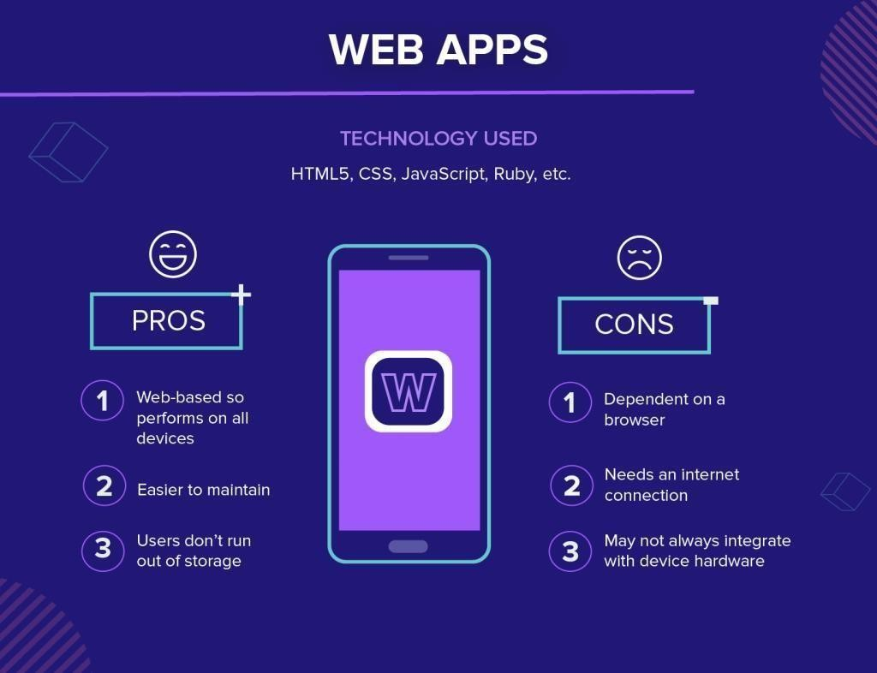
INTRODUCTION TO MOBILE APPLICATION

Slide 13
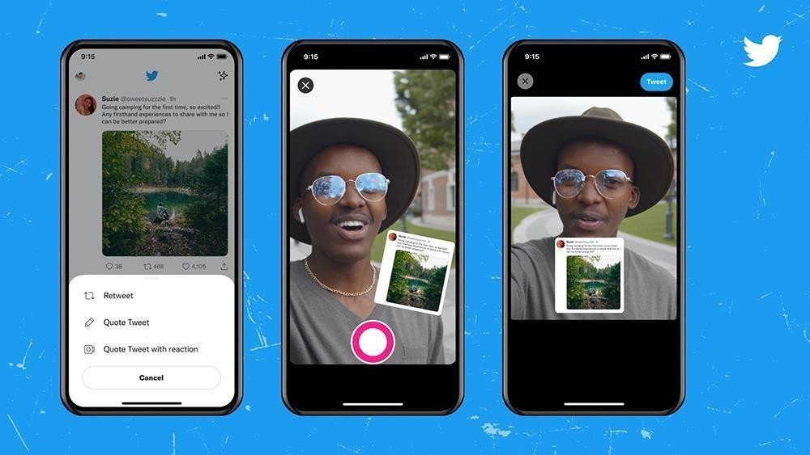
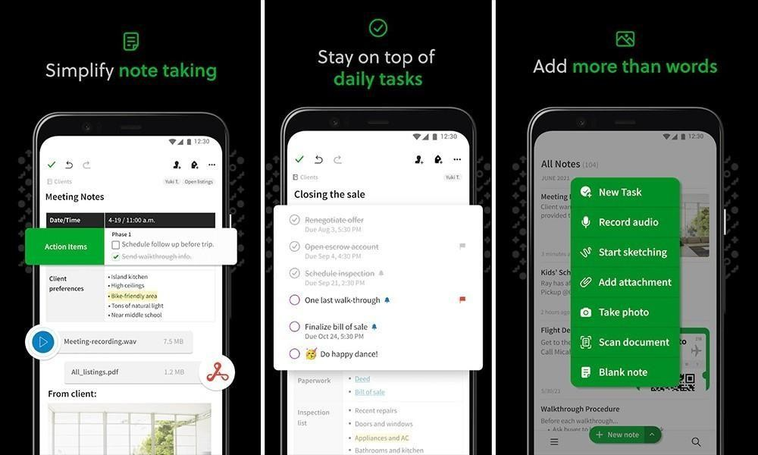
INTRODUCTION TO MOBILE APPLICATION
Hybrid Apps
A hybrid mobile app combines the elements of a native app and a web app.
The application’s core is written using web technologies (HTML, CSS, and JavaScript), which are then encapsulated within a native application.
It is run from within a native application and its own embedded browser, essentially invisible to the user.
Through the use of plugins, these applications can have full
access to the mobile device’s features.
Users can download the app from an app store and install it locally

Slide 14
ANATOMY OF MOBILE APPLICATION
Operating
System
Hardware Resources
Anatomy of Mobile Application
User Interface
Back End

Slide 15
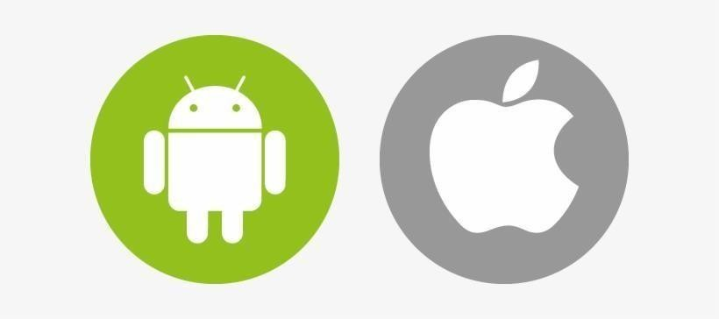
ANATOMY OF MOBILE APPLICATION
Operating system
Majority of smart phones run either Android (developed by Google) or iOS (Apple’s mobile OS).
The operating system controls the whole phone, in particular providing access to hardware functions such as the GPS, data network, motion sensors and storage.
It also coordinates things like notifications (more on those later).

Slide 16
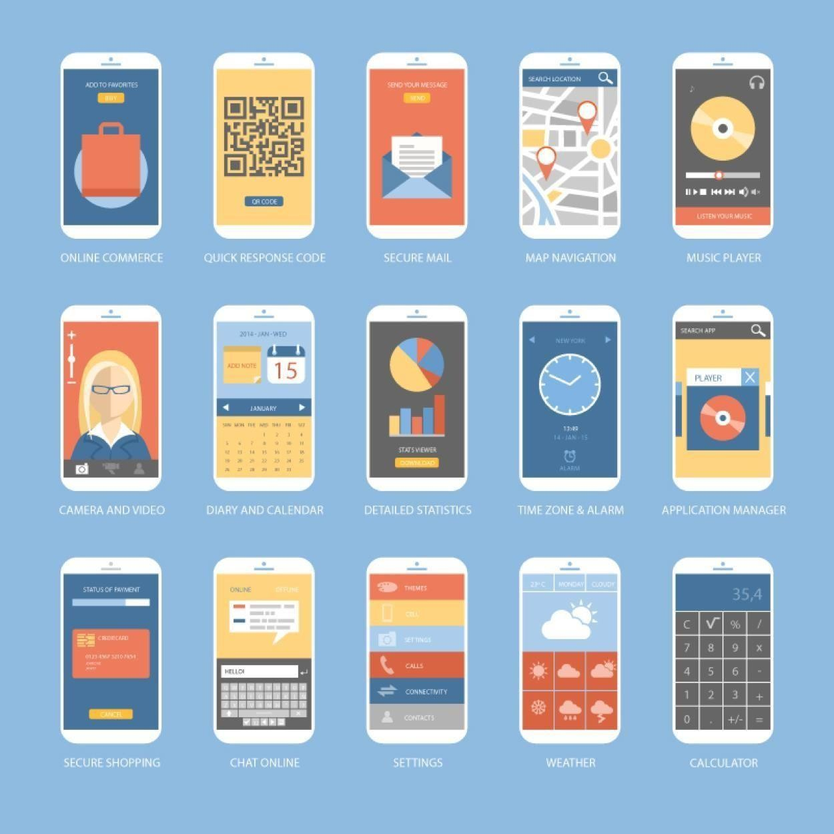
ANATOMY OF MOBILE APPLICATION
User Interface
The user interface or UI is a combination of what you see when you load and run your app and the way you interact with it.
The different elements of the UI combine to provide you with a good user experience (or UX).

Slide 17
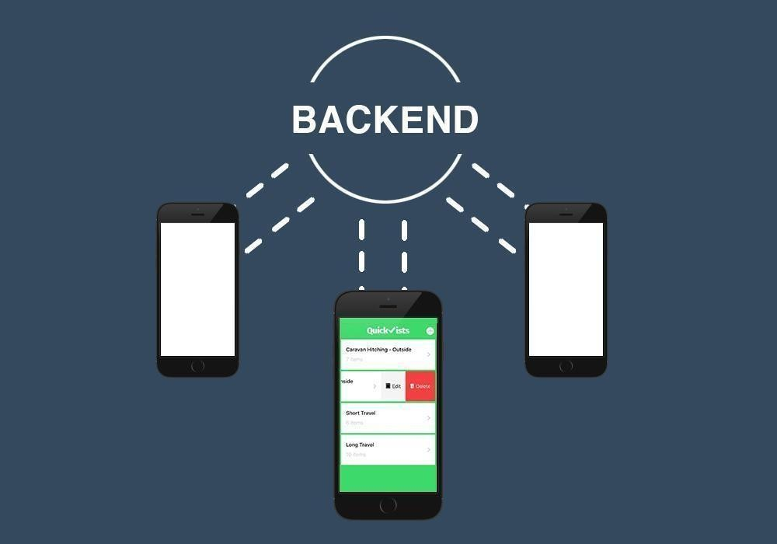
ANATOMY OF MOBILE APPLICATION
Back End
A back-end service provides the functionalities that the app needs to store and manage data, authenticate users, process and analyze data, and communicate with other systems or services.

Slide 18
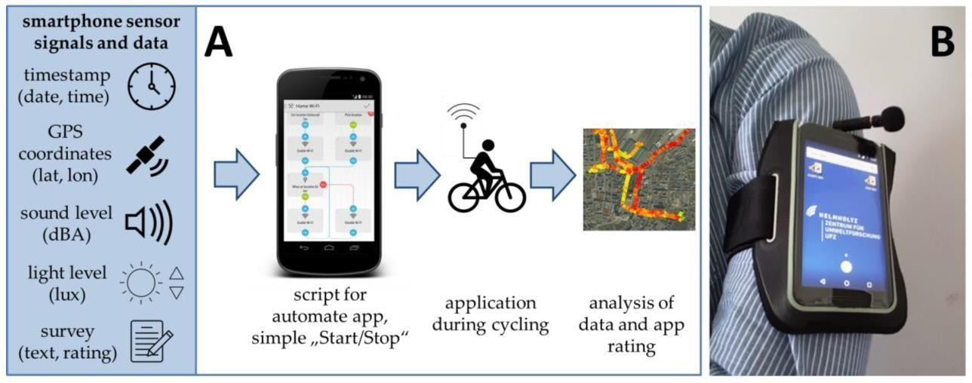
ANATOMY OF MOBILE APPLICATION
Hardware Resources
On most modern phones there are a huge array of sensors and services that the app could access.
These hardware include GPS for giving your position, accelerometers to track the movement of your phone, the speaker or other audio outputs, the microphone and the camera(s)

Slide 19
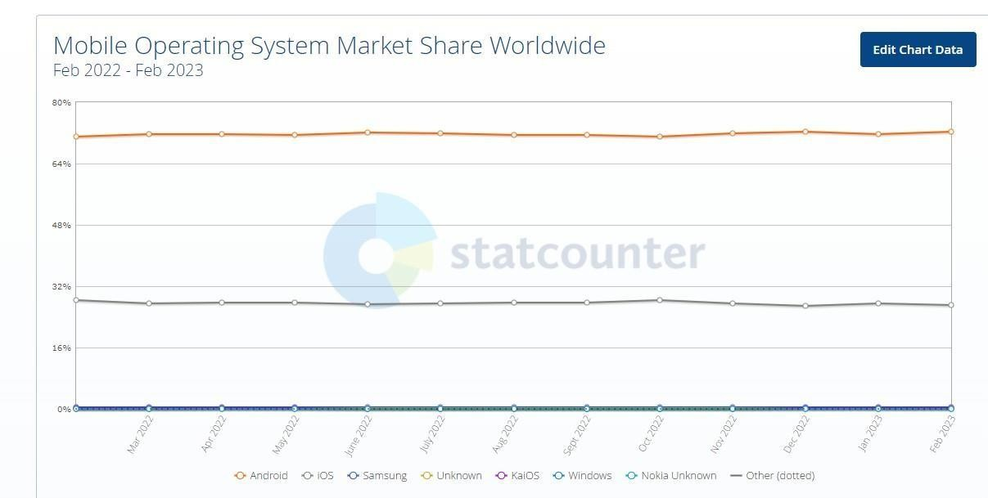
MOBILE APPLICATION MARKET TRENDS AND STATISTIC
Android
iOS
Source: https://gs.statcounter.com/os-market-share/mobile/worldwide

Slide 20
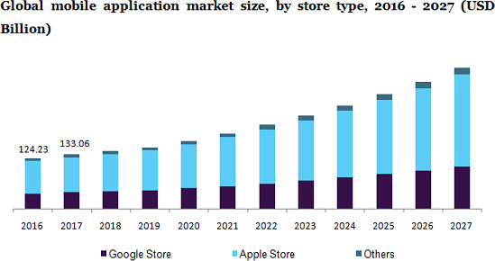
MOBILE APPLICATION MARKET TRENDS AND STATISTIC

Slide 21
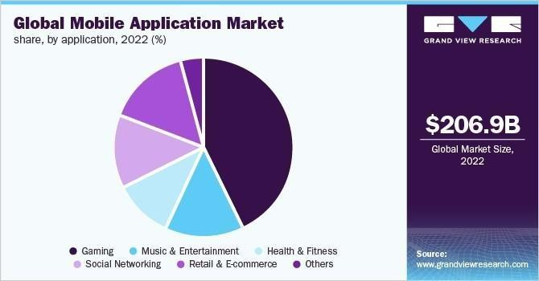
MOBILE APPLICATION MARKET TRENDS AND STATISTIC

Slide 22
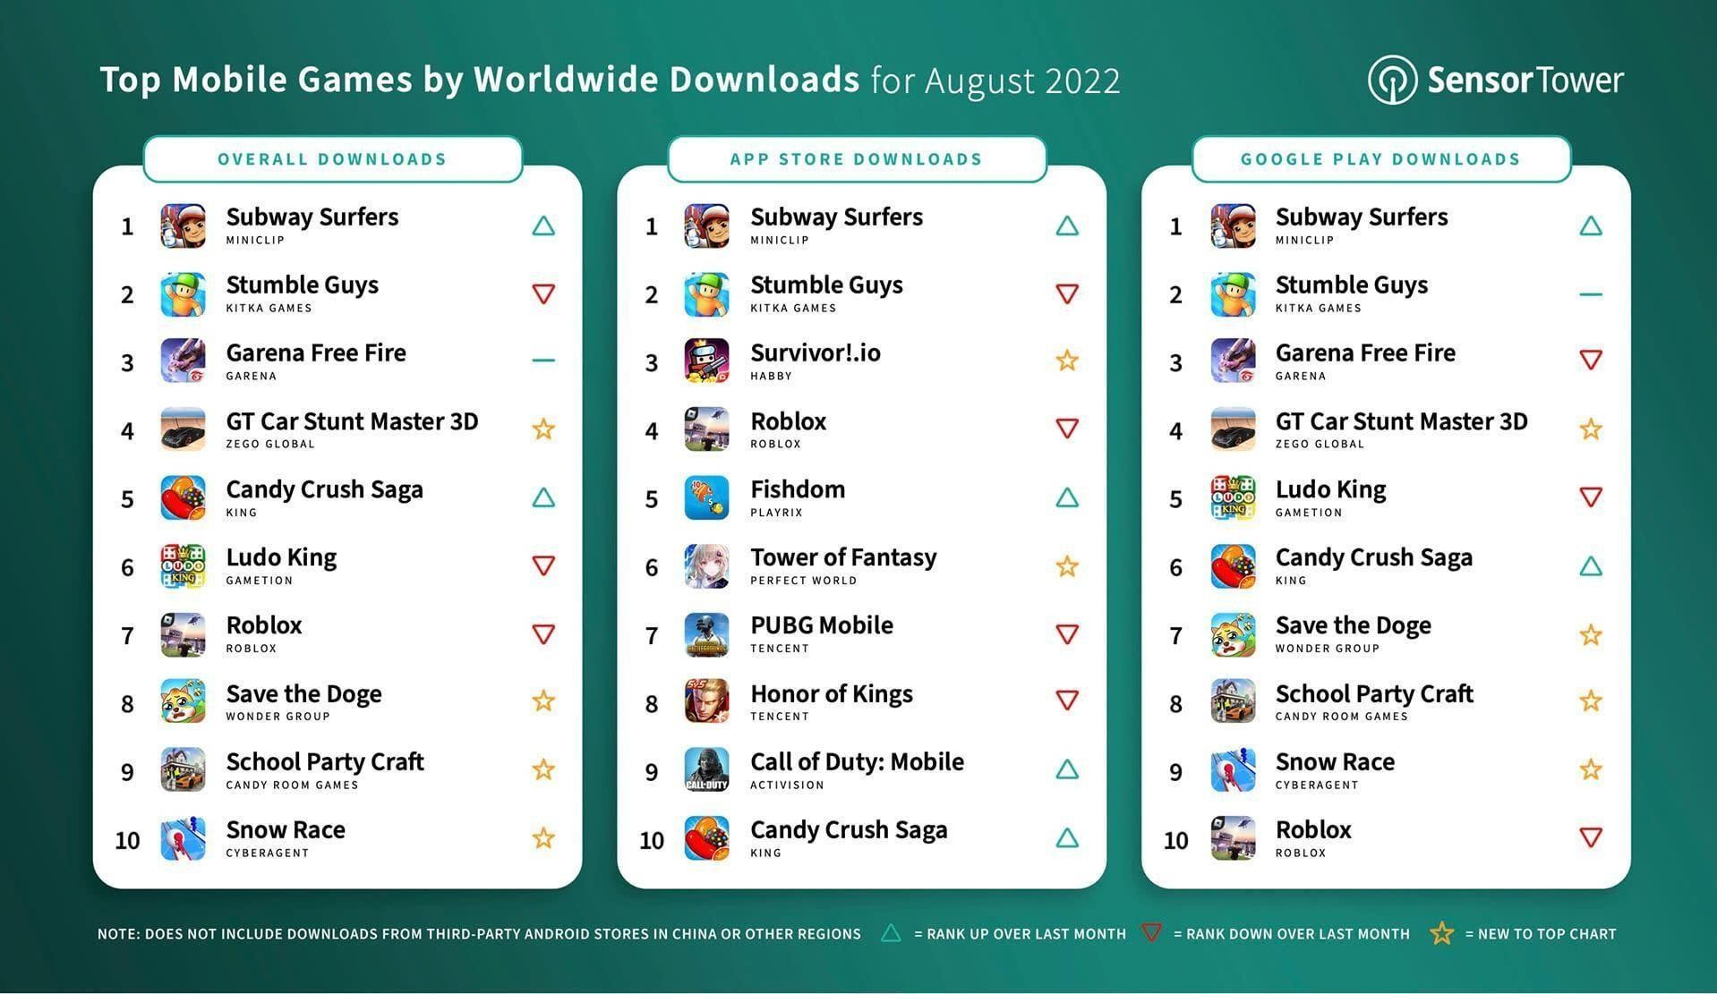
MOBILE APPLICATION MARKET TRENDS AND STATISTIC

Slide 23

MOBILE APPLICATION RESEARCH AND DESIGN
Market research is the first step of every mobile app development project.
Mobile app market research helps validate your app idea and ensures your app is addressing existing market needs.

Slide 24
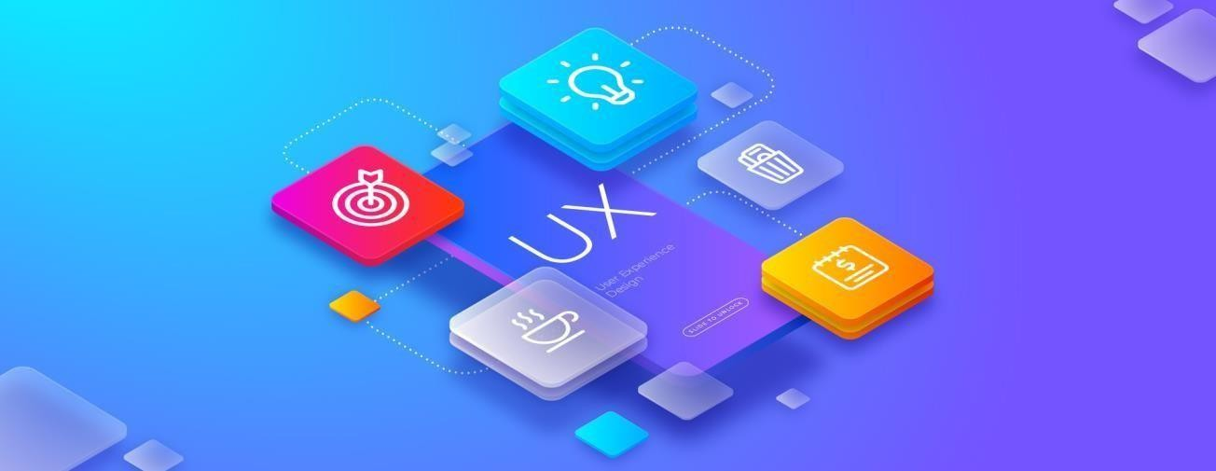
MOBILE APPLICATION RESEARCH AND DESIGN
User Experience (UX) and UX Research
User Experience refers to the feeling users experience when using a product, application, system,
or service.
UX (user experience) research is the systematic investigation of users and their requirements, in order to add context and insight into the process of designing the user experience.
UX research employs a variety of techniques, tools, and methodologies to reach conclusions, determine facts, and uncover problems, thereby revealing valuable information which can be fed into the design process.

Slide 25

MOBILE APPLICATION RESEARCH AND DESIGN

Slide 26
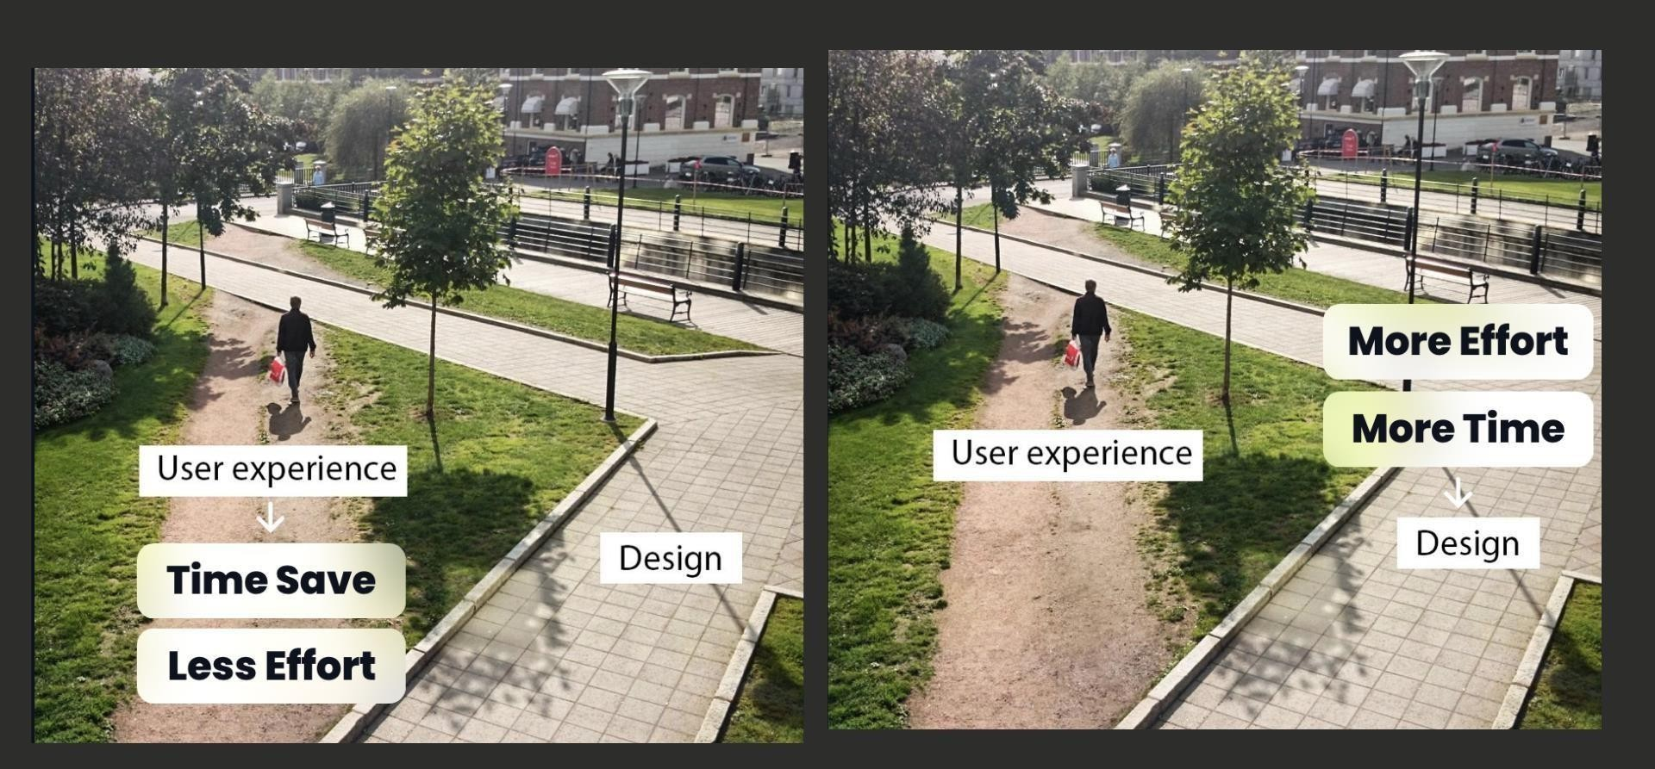
MOBILE APPLICATION RESEARCH AND DESIGN

Slide 27
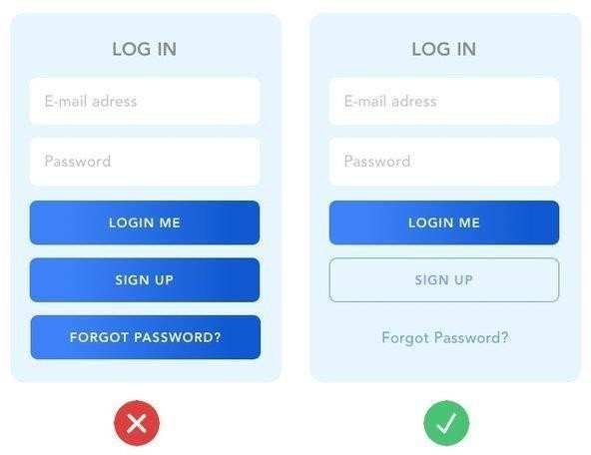
Example of good and bad UX design

Slide 28
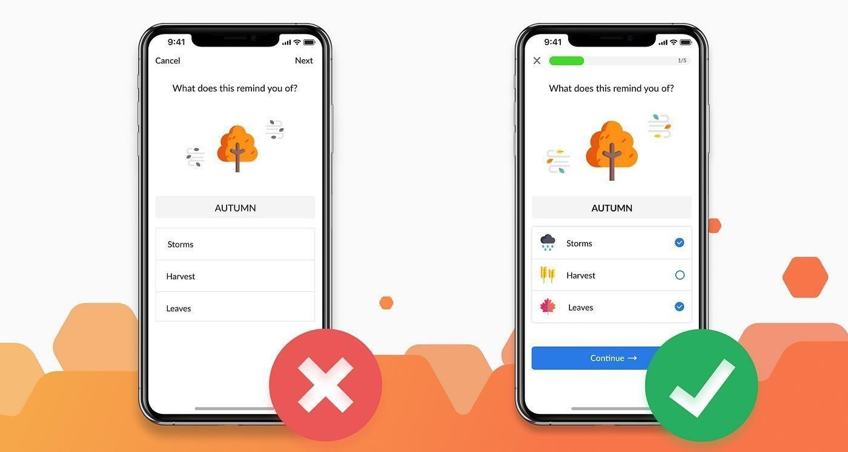
Example of good and bad UX design

Slide 29
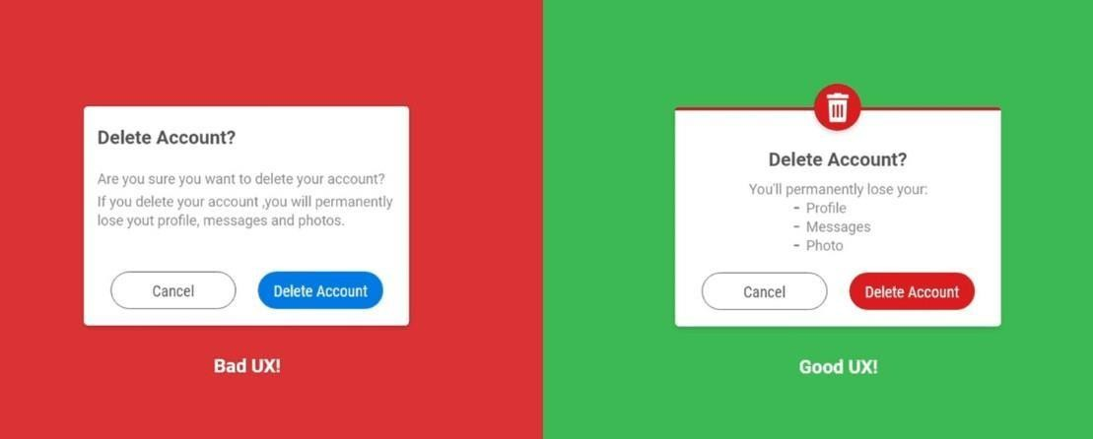
Example of good and bad UX design

Slide 30
MOBILE APPLICATION RESEARCH AND DESIGN
User Research for Mobile Applications.
Qualitative User Research Methods for Mobile Apps
Lab Studies
Journal/Diary Studies
Observational/Field Studies
Quantitative User Research Methods for Mobile Apps
Online Surveys (including Behavioral Tracking)
Behavioural Analysis
Experience Sampling Method (ESM)

Slide 31

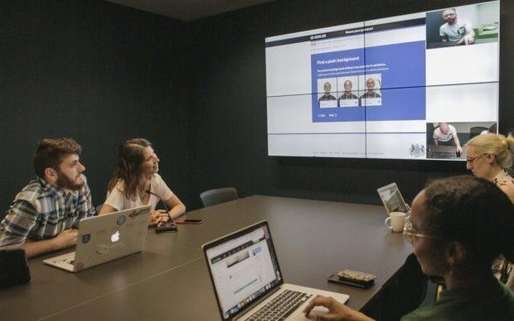
MOBILE APPLICATION RESEARCH AND DESIGN
Qualitative User Research Methods : Lab Studies
Lab studies are designed to test whether the user can actually use the product.
A lab study is conducted using a mobile device in an environment where the user can be observed by the research team.
This will often involve the researcher remaining in a different room observing remotely while the user goes about their tasks.

Slide 32
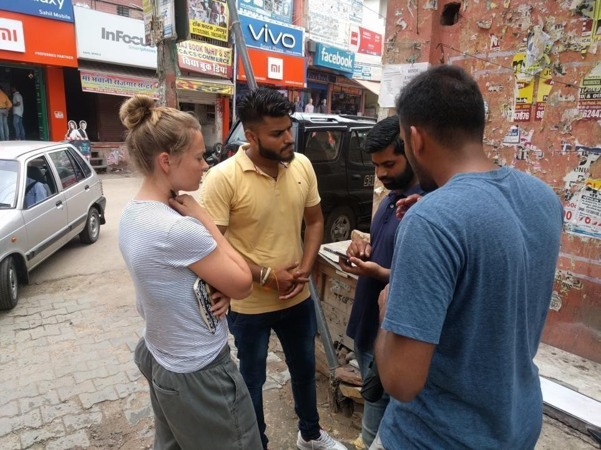
MOBILE APPLICATION RESEARCH AND DESIGN
Qualitative User Research Methods: Observational/Field Studies
Researchers meet with test participants in their natural environment (where they would most likely encounter the product), observe how users interact with a product, and ask related questions.

Slide 33
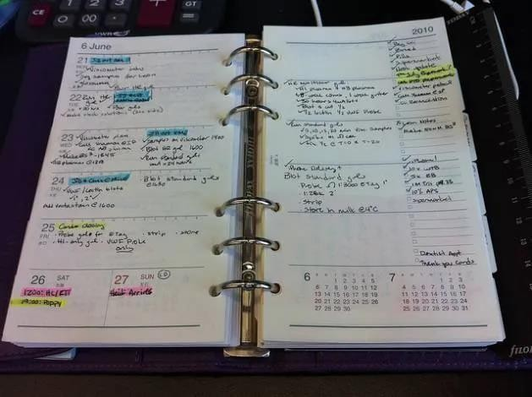
MOBILE APPLICATION RESEARCH AND DESIGN
Qualitative User Research Methods: Journal/Diary Studies
Test participants are given a mechanism to record and describe aspects of their lives relevant to a product.
The diary can be physical or online. Typically, test participants document their activities over a prolonged period.

Slide 34
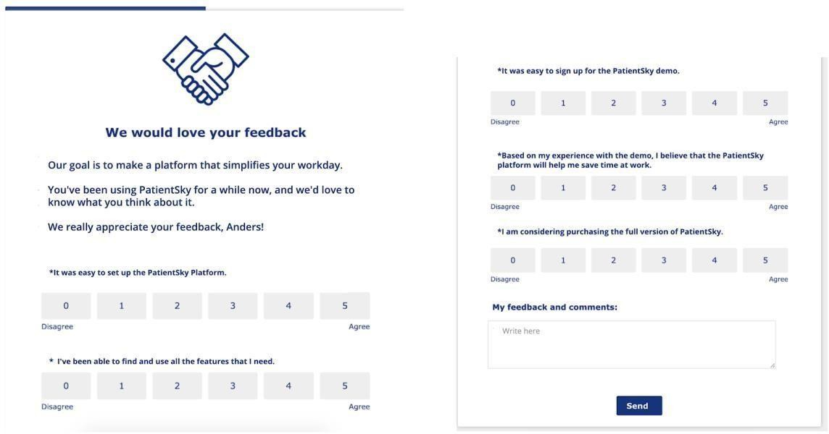
MOBILE APPLICATION RESEARCH AND DESIGN
Quantitative User Research Methods : Online Surveys (including Behavioural Tracking)
Online surveys will involve using a questionnaire combined with automated data collection reflecting the user’s actual behaviour.
They are designed to answer the questions;
“What do users think of our product? What do they perceive the value to be?”
Online surveys are incredibly cost-effective and can create large amounts of data on a geographically diverse basis which, in turn, leads to statistically significant sample sizes and results.

Slide 35
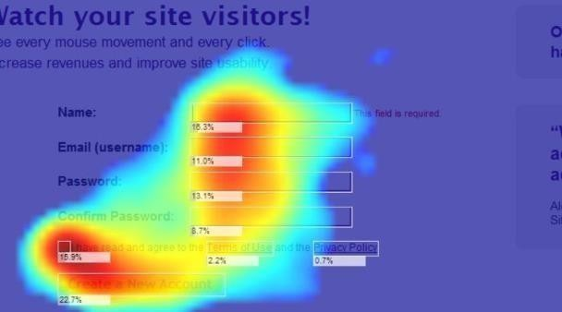
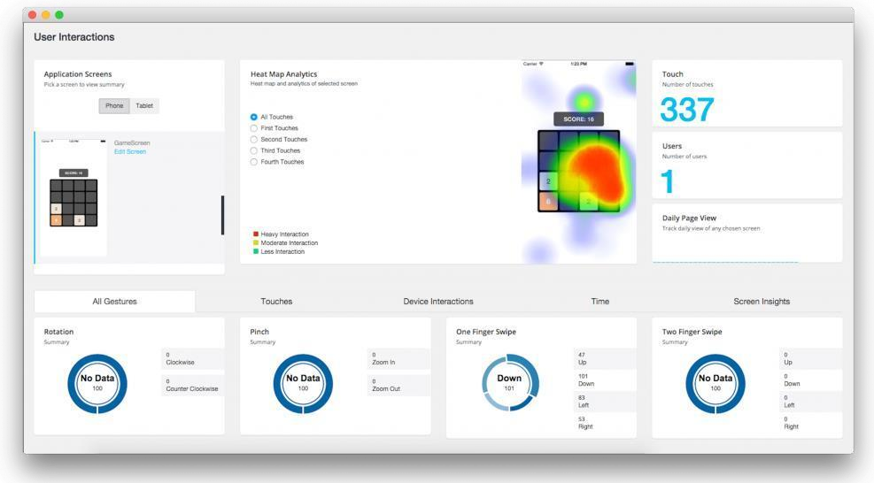
MOBILE APPLICATION RESEARCH AND DESIGN
Quantitative User Research Methods: Behavioural Analysis
Interaction heatmap
Behavioral analysis works to determine the answer to the “How do people use our app?” question.
It is conducted via installed software on the users’ devices that tracks how people navigate the app and how they conduct the tasks on your app.

Slide 36
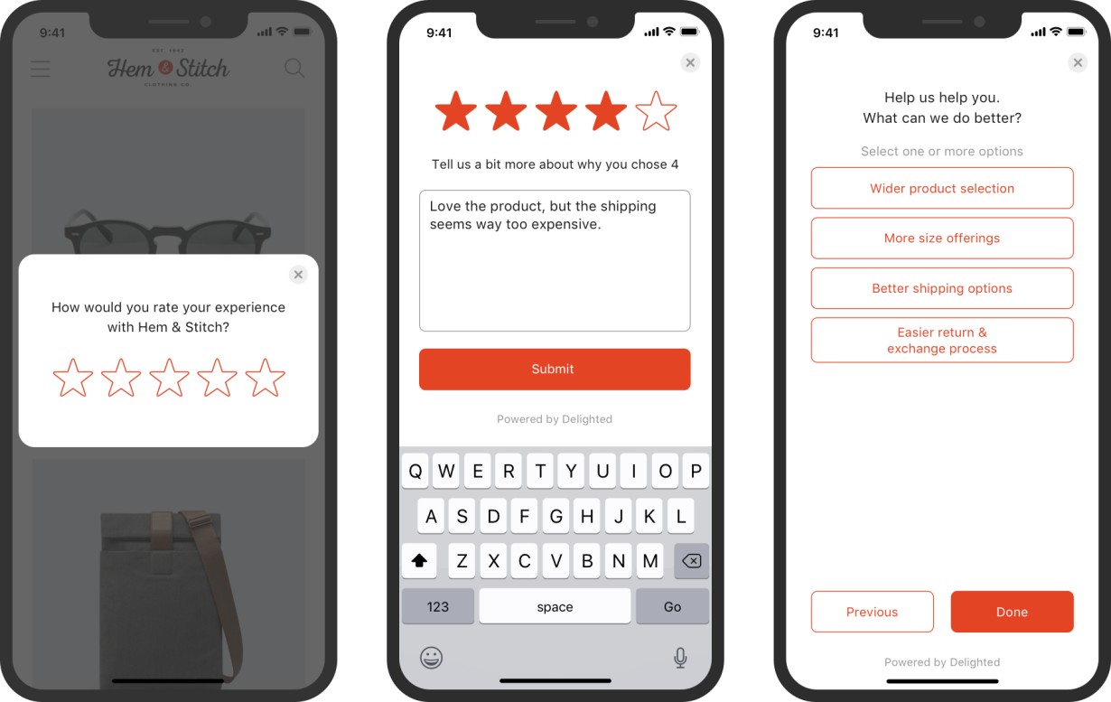
Mobile Application Research and Design
Quantitative User Research Methods: Experience Sampling Method (ESM)
This method is beneficial in mobile user research because it consists of sending automated messages to the study participants at the point they carry out an action to ask about their experience.
It helps answer two main questions;
“How does the user use our app?” and “What do they think about that?”

Slide 37
CLASS DISCUSSION :WHAT IS YOUR DREAM APP?
What is the current issue and problem that need to solve?
Is it possible to solve with using mobile application?
Write on a note and state the current issue, your idea and what is possible solution you have?
All student to share their opinion and perspective.
-padlet-

Slide 38
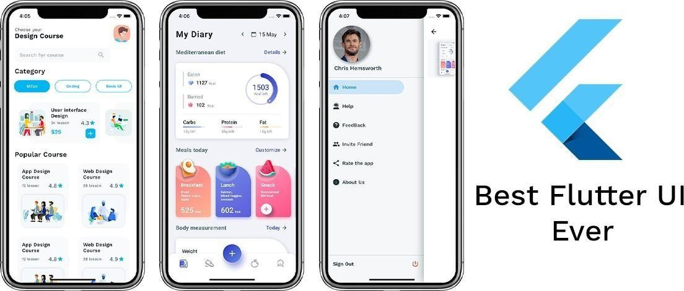
MOBILE APP DEVELOPMENT FRAMEWORK
Native App Framework
Flutter
Flutter is a free and open-source mobile UI framework created by Google and released in May 2017
Flutter is used by developers and organizations
worldwide and is free and open source.
To develop with Flutter, you will use a programming language called Dart.
https://flutter.dev/
Official Website

Slide 39
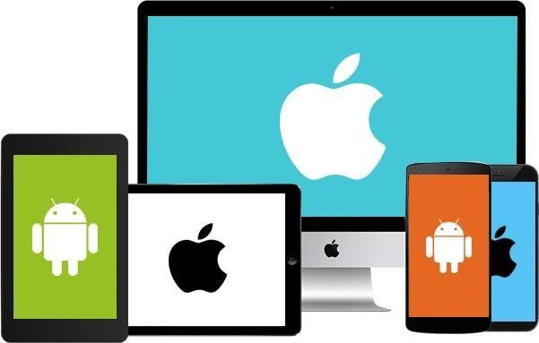
MOBILE APP DEVELOPMENT FRAMEWORK
Why Flutter?
One codebase for all platforms
Not necessarily writing code for Android and another codebase for iOS devices.
Flutter’s code reusability allows you to write just one codebase and use it for mobile Android and iOS, web, desktop, and more.
This significantly cuts development time, removes costs, and enables you to launch your app much faster.

Slide 40
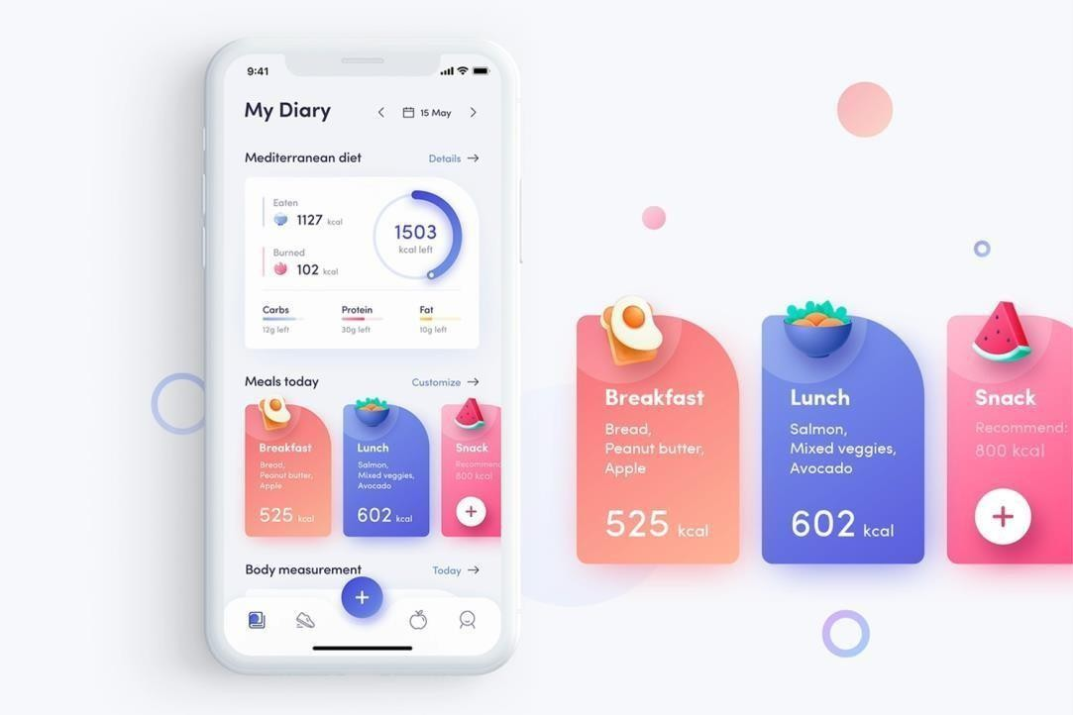
MOBILE APP DEVELOPMENT FRAMEWORK
Why Flutter?
Rich libraries
It has a rich graphics library, which is fast and mature enough to create stunning user interfaces.

Slide 41
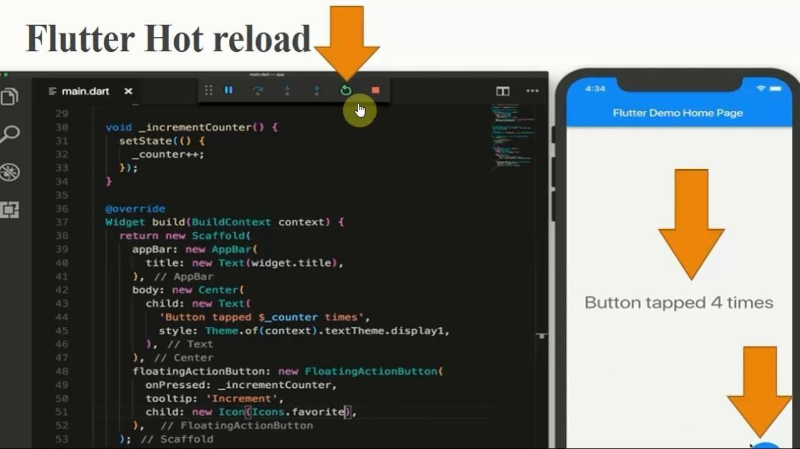
MOBILE APP DEVELOPMENT FRAMEWORK
Why Flutter?
Fast testing with hot reload
The hot reload feature makes the app development much quicker.
With Flutter, reloading the app to see every change
you make in the code is unnecessary.
You can easily make changes in your app in real-time, allowing you to experiment with the code and fix bugs on the go.

Slide 42
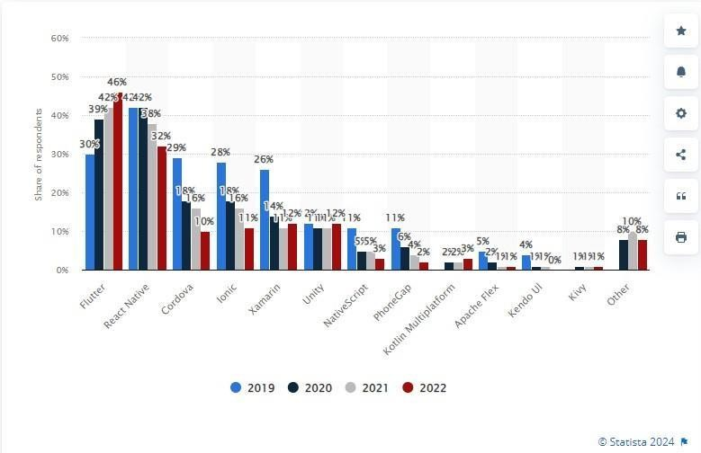
Why Flutter?
Cross-platform mobile frameworks used by software
developers worldwide from 2019 to 2022
Popularity
One of the most popular cross-platform mobile frameworks used by developers worldwide.
The popularity is increasing from year to year.
This means Flutter has a very large community group where we can easily get support to troubleshoot some development issues.

Slide 43
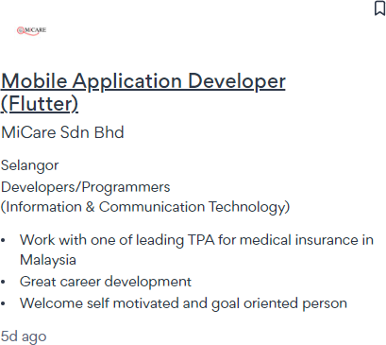
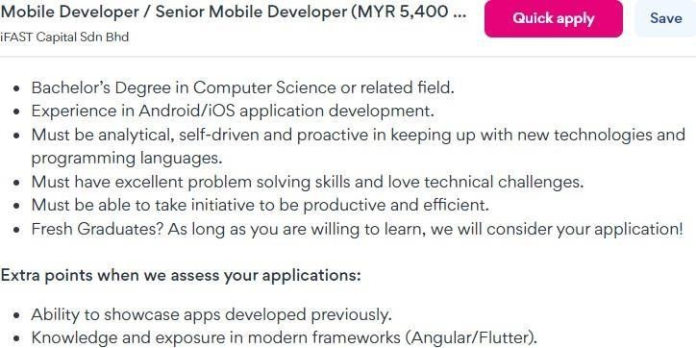
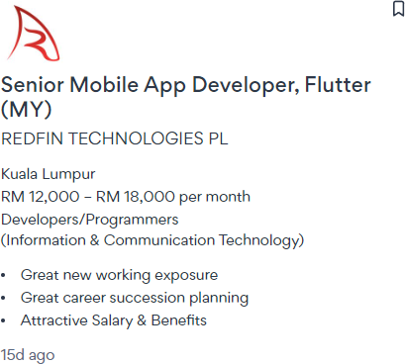
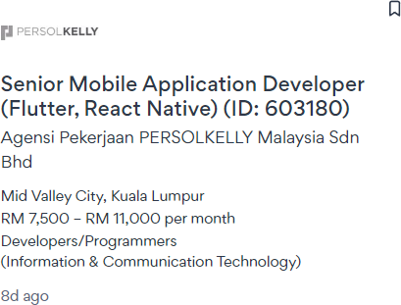
MOBILE APP DEVELOPMENT FRAMEWORK
Why Flutter?
Great Job Opportunities
A high demand skill in the current job market for a mobile app developer
Flutter or React Native is commonly one of the preferable skills required
Stand a better chance to get a high salary job with years of experience.

Slide 44
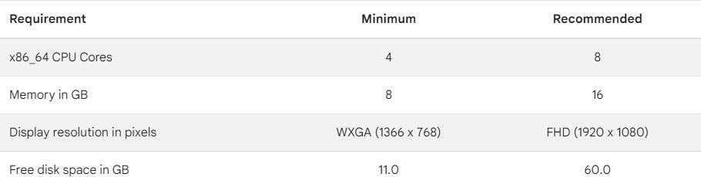
MOBILE APP DEVELOPMENT FRAMEWORK
Hardware Requirement of Flutter (Windows)

Slide 45
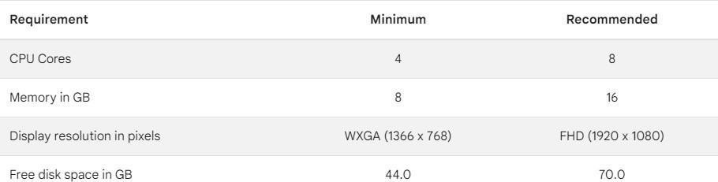
MOBILE APP DEVELOPMENT ENVIRONMENT SETUP
Hardware Requirement of Flutter (MacOS)

Slide 46
SEE YOU NEXT CLASS

